Slide 1
Budget Hearing #1
05/09/2023

Slide 2
Fiscal Year 2024 Budget Hearing #1
FY 2024 Revenues/Expenditures
Capital Improvement Plan
Personnel Request(s)
COLA

Slide 3
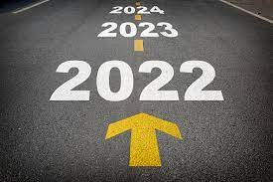
Vision

Slide 4
FY 2024 Revenues

Slide 5
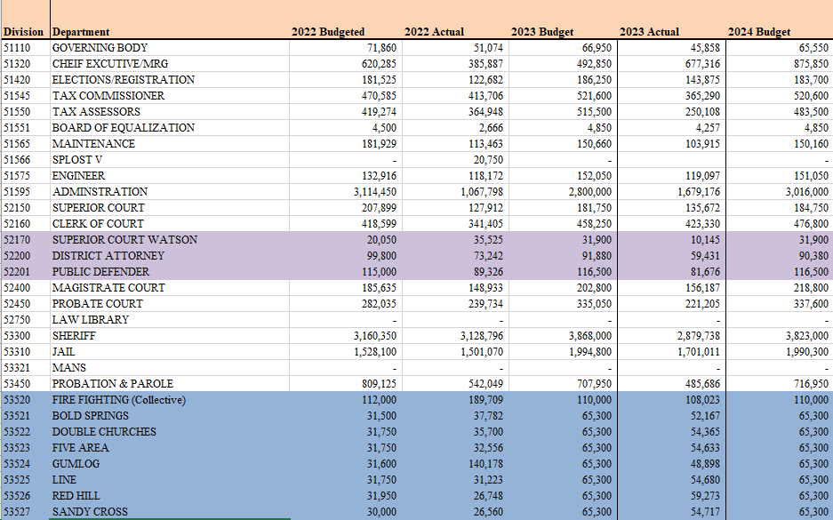
FY 2024 Expenditures

Slide 6
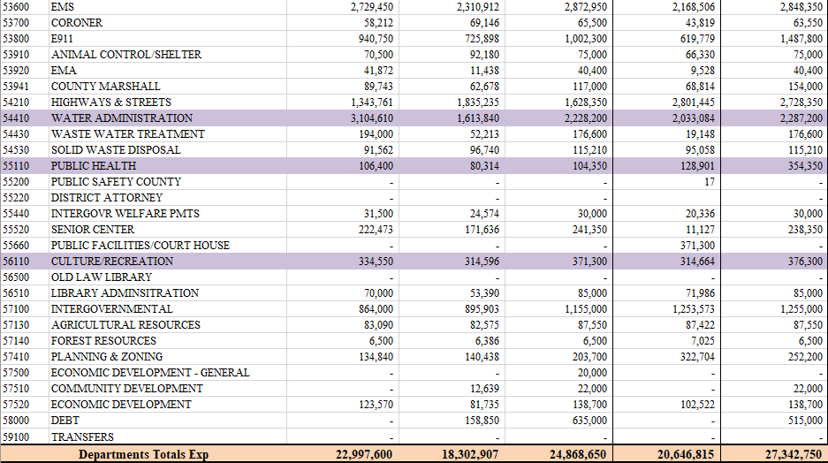
FY 2024 Expenditures

Slide 7
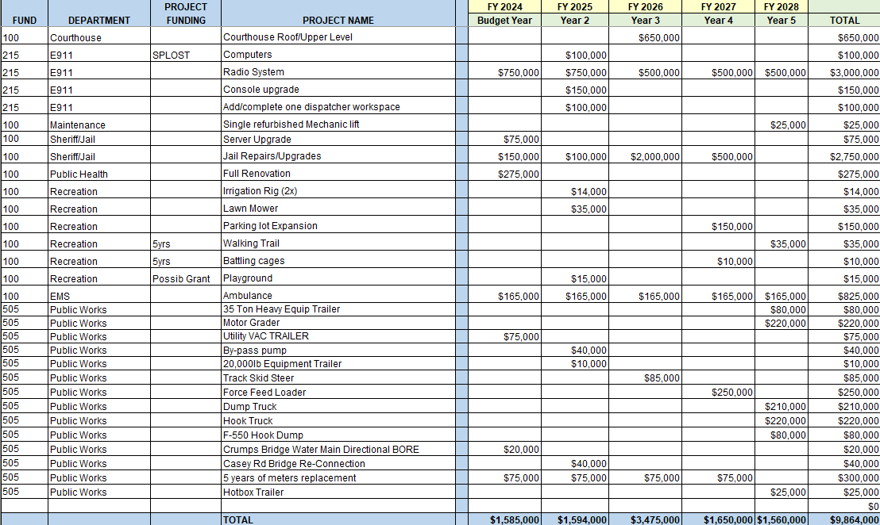
FY 2024 CIP

Slide 8
Expenses by Fund
General Fund- $18,788,990.00
E911 Fund: $987,800.00
Probation Fund: $716,950.00
SPLOST Fund: $4,270,000.00
Water Fund: $2,463,800.00
Landfill Fund: $115,210.00

Slide 9
Capital Improvement Plan-5 Years
The purpose of the CIP is to create a plan to coordinate the maintenance and operational capital of the County. This plan is still flexible, but allocates a certain dollar value to the completion of major projects over $5,000. These are estimates of project costs and each year will be re-evaluated.
FY 2024-$1,585,000
FY 2025-$1,594,000
FY 2026-$3,475,000
FY 2027-$1,650,000
FY 2028-$1,560,000

Slide 10
Personnel Request(s)
The County is at a position where there are personnel needs to handle not only the future capacity, but the growth that has occurred over the past years.
Positions can be funded at various percentages:
July 1-100% Funding
January 1-50% Funding

Slide 11
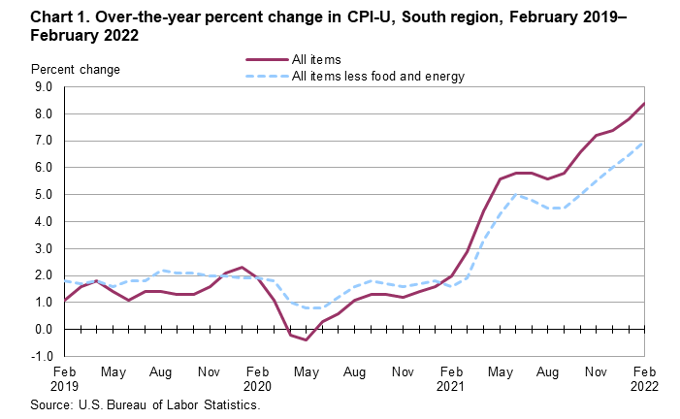
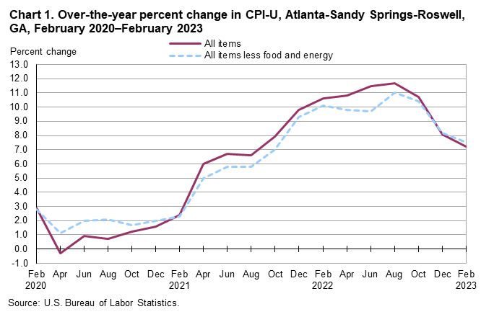
COLA-Cost of Living Allowance
8.4%
7.2%

Slide 12
Cost of Living Allowance-cont’d

