Slide 1
Budget Hearing #2
05/30/2023

Slide 2
Fiscal Year 2024 Budget Hearing #2
FY 2024 Revenues/Expenditures
Capital Improvement Plan
Personnel Improvements
COLA
General Information

Slide 3
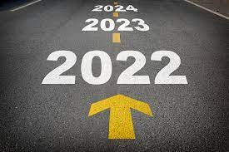
Vision

Slide 4
FY 2024 Revenues
Original Revenue: $27,372,160.00
Adjusted Revenue (Adjusted): $27,422,160.00

Slide 5
FY 2024 Expenditures
Original Expenditure: $27,342,750.00
Adjusted Expenditures (Projected): $27,385,850.00

Slide 6
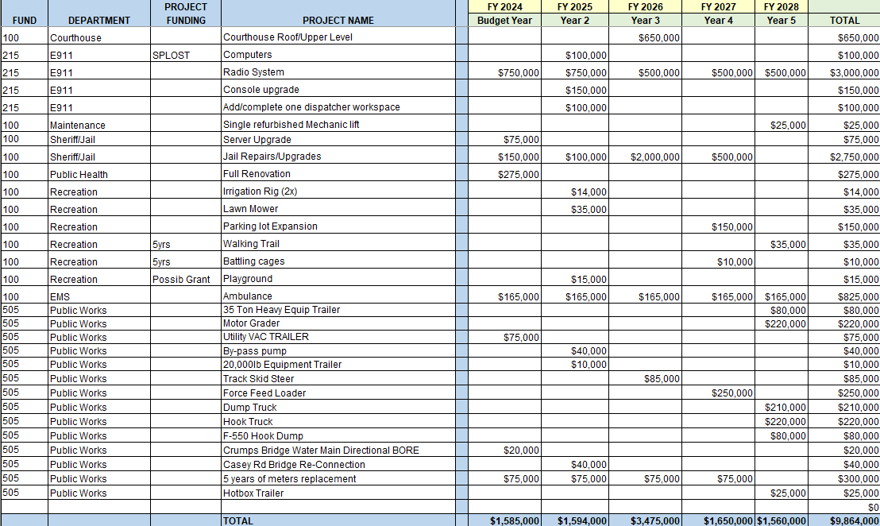
FY 2024 CIP

Slide 7
Capital Improvement Plan-5 Years
The purpose of the CIP is to create a plan to coordinate the maintenance and operational capital of the County. This plan is still flexible, but allocates a certain dollar value to the completion of major projects over $5,000. These are estimates of project costs and each year will be re-evaluated.
FY 2024-$1,585,000
FY 2025-$1,594,000
FY 2026-$3,475,000
FY 2027-$1,650,000
FY 2028-$1,560,000

Slide 8
Personnel Improvement(s)
The County is at a position where there are personnel needs to handle not only the future capacity, but the growth that has occurred over the past years.
The BOC is proposing adding an additional $1.00 in hourly wage to the Public Works Department. This would include Water, Roads and Solid Waste. This increase across the entirety of that department would translate into these departmental budgets changing as listed below:
Water Administration: $2,287,200 to $2,292,600
Highways & Streets: $2,728,350 to $2,757,950
Solid Waste Disposal: $115,210 to $123,310

Slide 9
Cost of Living Allowance-cont’d

Slide 10
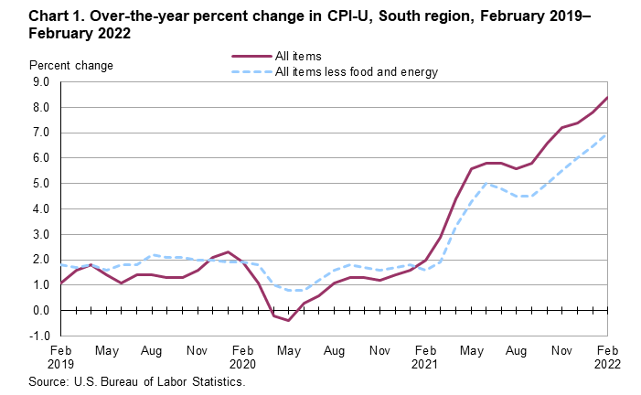
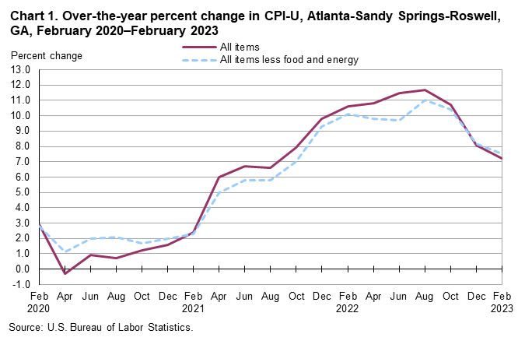
COLA-Cost of Living Allowance
8.4%
7.2%

